Slide 1

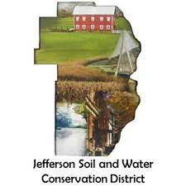
CAUV
Jefferson County Auditor’s Office
&
Jefferson Soil and Water Conservation District
Notes:
We get a lot of questions regarding CAUV, from how to apply to what qualifies. Hopefully the following presentation can cover these frequently asked questions.

Slide 2
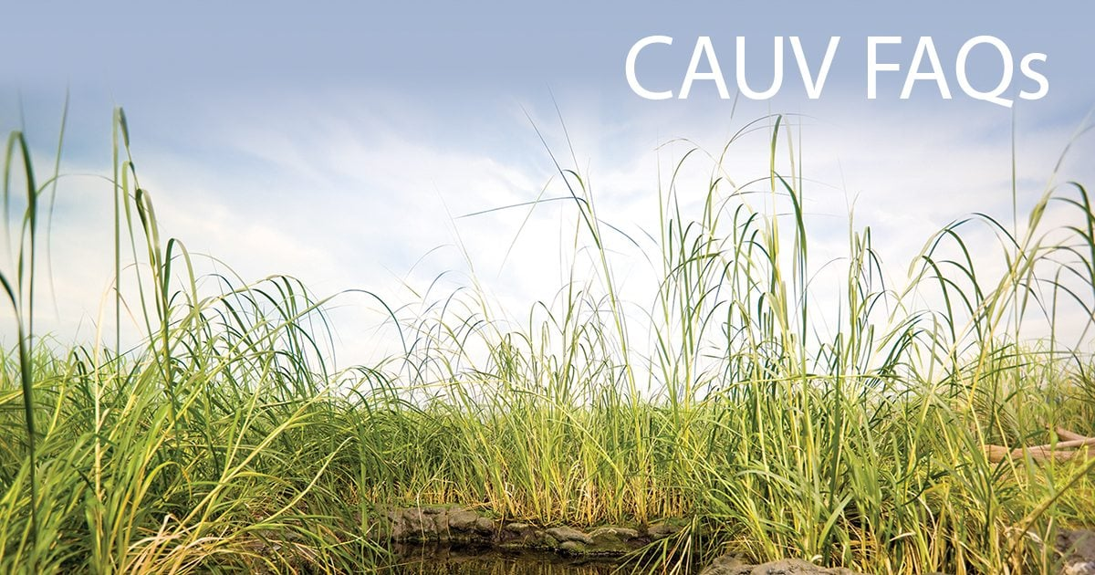
What is CAUV?
CAUV is the Current Agricultural Use Value. This is agricultural land use devoted exclusively to commercial agriculture which is to be valued based on the value of agriculture rather than the full market value.
Notes:
CAUV is the agricultural land that is devoted to agricultural usage. CAUV is valued based on the value of agriculture rather than the full market value. Landowners in CAUV will see a reduced amount on their taxes each year that they are on the program.

Slide 3
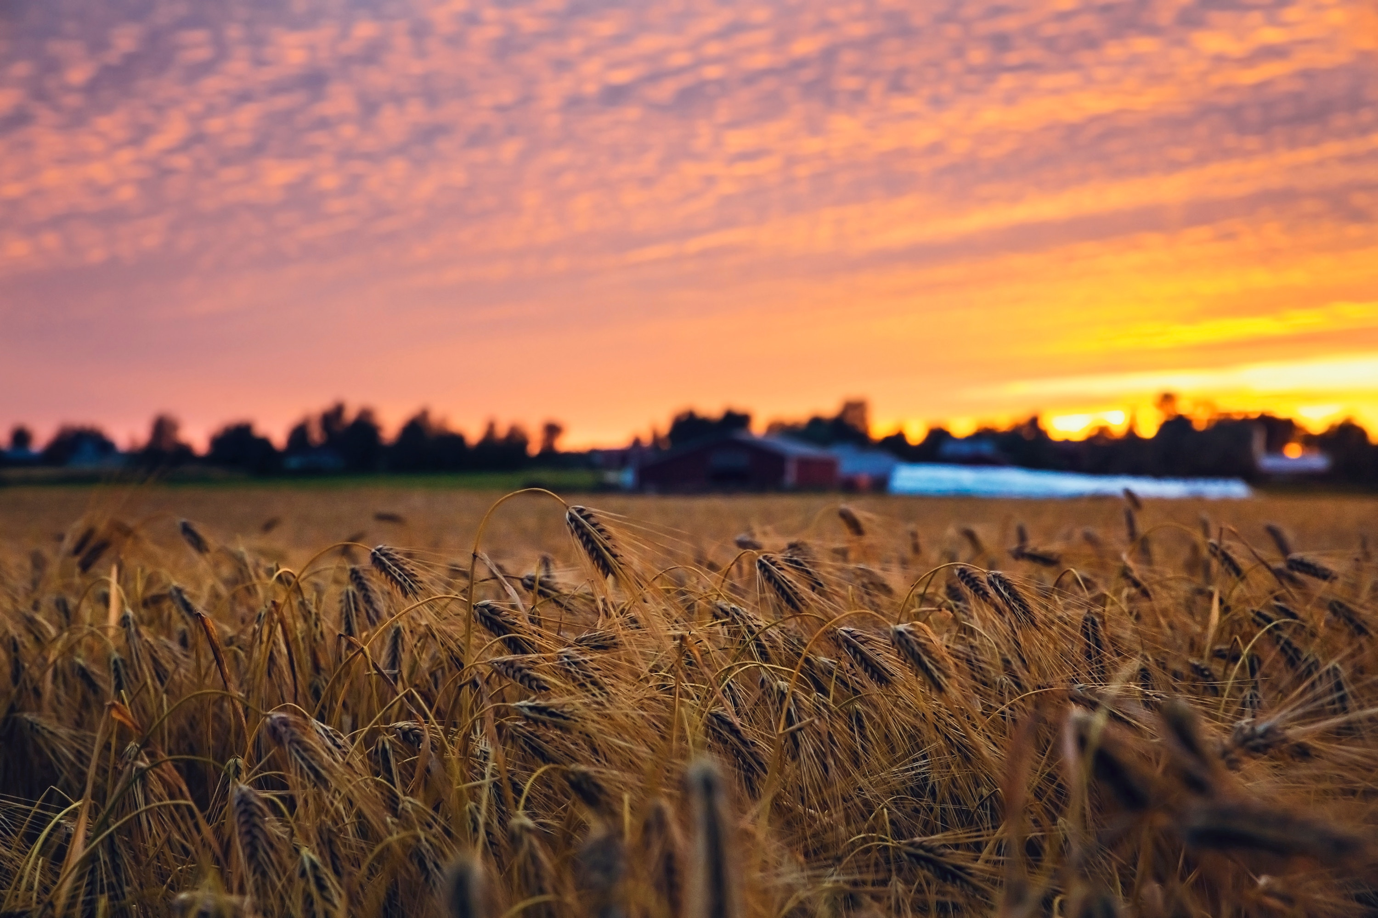
Why apply for CAUV?
Designed to give farmers the opportunity to retain their acreage and reinvest in their land.
Done through a tax reduction set by the state.
Allows landowners to use the saved income to invest in their property.
Notes:
CAUV is an incentive program designed to give farmers the opportunity to retain their acreage and re-invest in their land, done through a tax reduction based on what is set through the state.
By saving the farmer or woodland producer money this will allow them to put the money they are saving to enhance their farm or woodlot or for programs such as EQUIP.

Slide 4
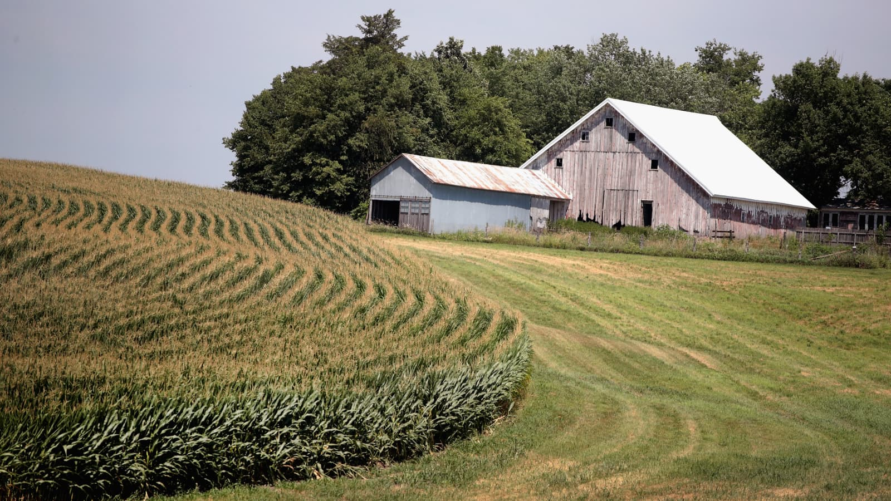
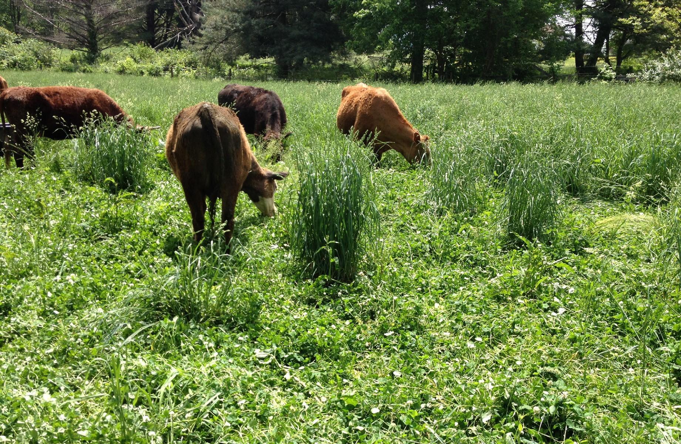
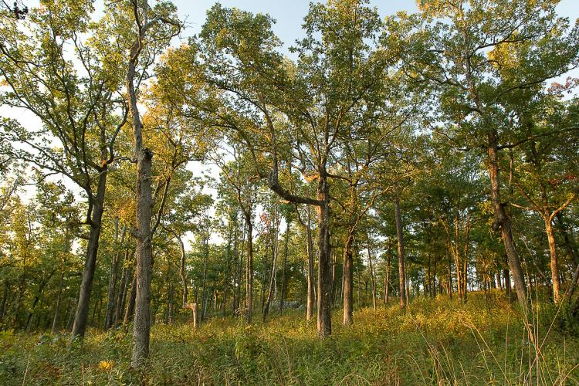
How do I know if I qualify?
Devoted to agricultural use, woodland production, or enrolled in a federal program.
10 acres or more. If less than 10 acres must show a $2,500 gross annual income.
Can lay fallow for a year.
Notes:
If your land is devoted to agricultural use, woodland production, or in a federal program you will automatically qualify.
If the land is less than 10 acres it will still qualify, but you will have to show proof of a $2,500 gross annual income of that land for the prior 3 years before first applying.
If you have just bought the land before the application period and HAVE plans of turning it into a farm or woodland production you can still apply and be accepted on that year, but the following year when renewing the application you must be using the land for agricultural use or woodland production.

Slide 5

What if my land is enrolled in a Federal land retirement or a Conservation program?
You will automatically qualify!
Conservation practices qualify if 25% or less of the total acreage.
Notes:
You will still automatically qualify if you are in a Federal Land Retirement or a Conservation program.
You will also qualify if you have conservation practices that you follow on your land. To be eligible for that it must be 25% or less of the total acreage. This could be grass water ways, filter strips, or wetlands.
Maps must be shown for both a conservation program and conservation practices.

Slide 6
What if someone else farms my property?
You will still qualify because the land is still being farmed!
Notes:
WHAT IF MY LAND IS FARMED BY SOMEONE ELSE OTHER THAN ME?
That is still fine! As long as the property is still being used for agricultural use, anyone can farm the land.
On the application it will ask if someone other than the owner farms the land, if no you will mark no, if yes you will mark yes and provide contact information of that individual.

Slide 7
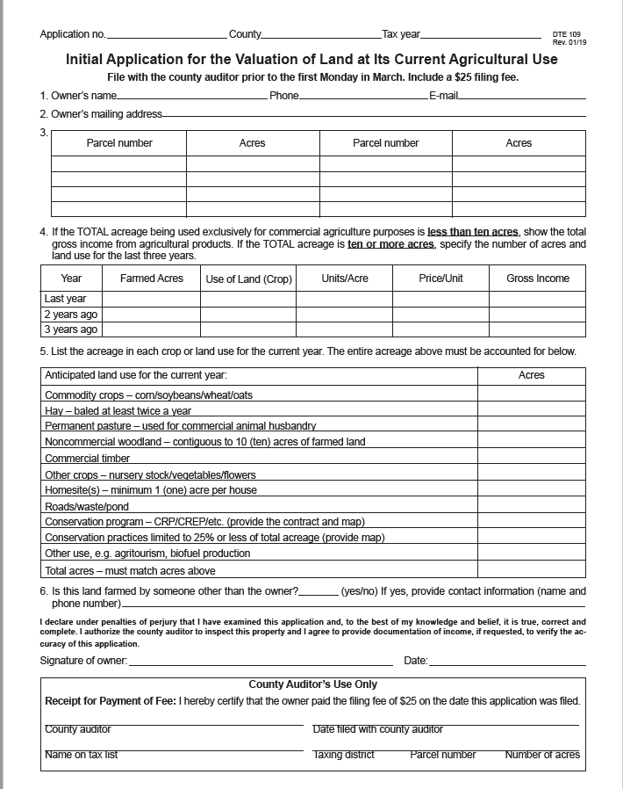
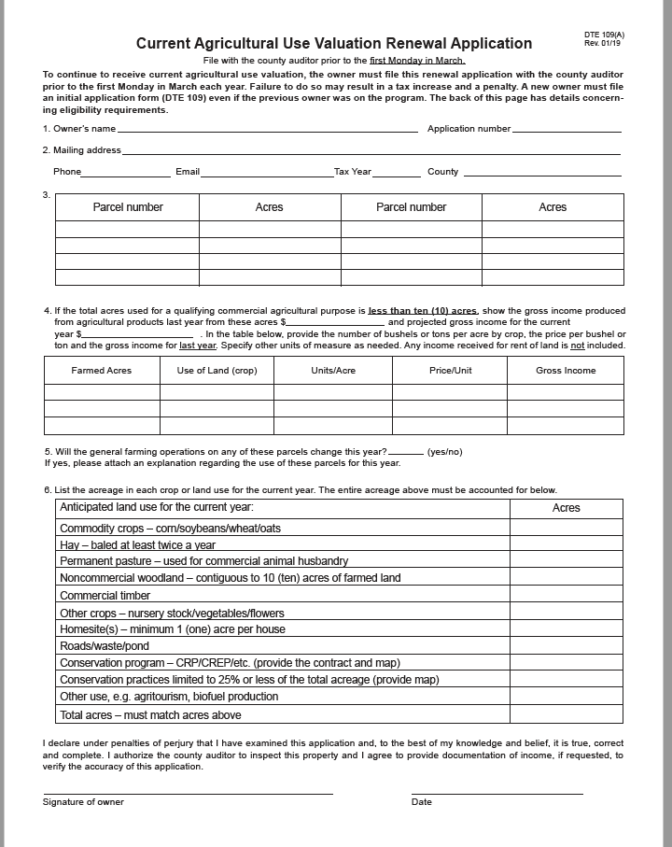
When can I apply?
Enrollment begins January 1st until the First Monday in March.
$25 filling fee when first applying, after that none.
Must be turned in by the first Monday in March to qualify!
Notes:
You can apply after the 1st of January until the first Monday in March. This is a set date made by the state and will not be changed.
There is a $25 filling fee when first applying, but once you start your renewal applications after that first year you will have no filling fee.
All applications must be turned in by the first Monday in March to be accepted or to stay on the CAUV program.

Slide 8
Where do I go to apply for CAUV?
First time applicants will apply at the Jefferson Soil and Water Conservation District. Please call Crystal at 740-264-9790, to schedule an appointment.
Renewals applicants can send forms to Auditors office or Jefferson SWCD.
Cannot make it? Applications are online through the Ohio Taxation Department.
Notes:
For first time applicants you can contact the Jefferson Soil and Water Conservation District to help you with the applications, please call before hand to make sure that I am in the office to help assist you with the application.
If you are a renewal applicant, you will receive a renewal form in the mail from the Auditor’s office, if you have any questions on your renewal applications please contact the Auditor’s office for those needs. You will need to apply each year! Each year that you are on it, this will help and benefit you!
First time applicants cannot make it to the office to receive the application? That is fine the “Initial applications” are available online through the Ohio Taxation Department! You can also call the Jefferson Soil and Water office and we can make arrangements to get the application to you.

Slide 9
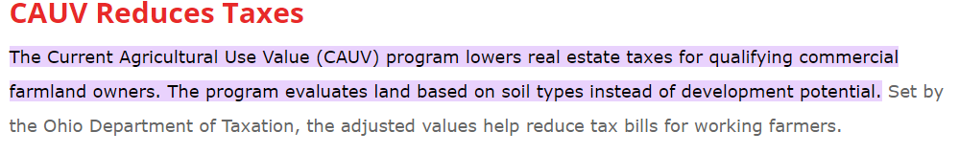
How much will this reduce my taxes?
Notes:
The reductions are dependent on the CAUV value which is placed upon the land. Some factors of that could indicate this are the soil types, soil regions, and potential use of land. Agriculture Commodity prices also add into the CAUV value. Tax value is set at 35% of the CAUV value. The CAUV value is readjusted on a three year cycle by the State Tax Commissioner to account for changing agricultural production costs and commodity.
This is set by the state and will vary accordingly to your land.

Slide 10
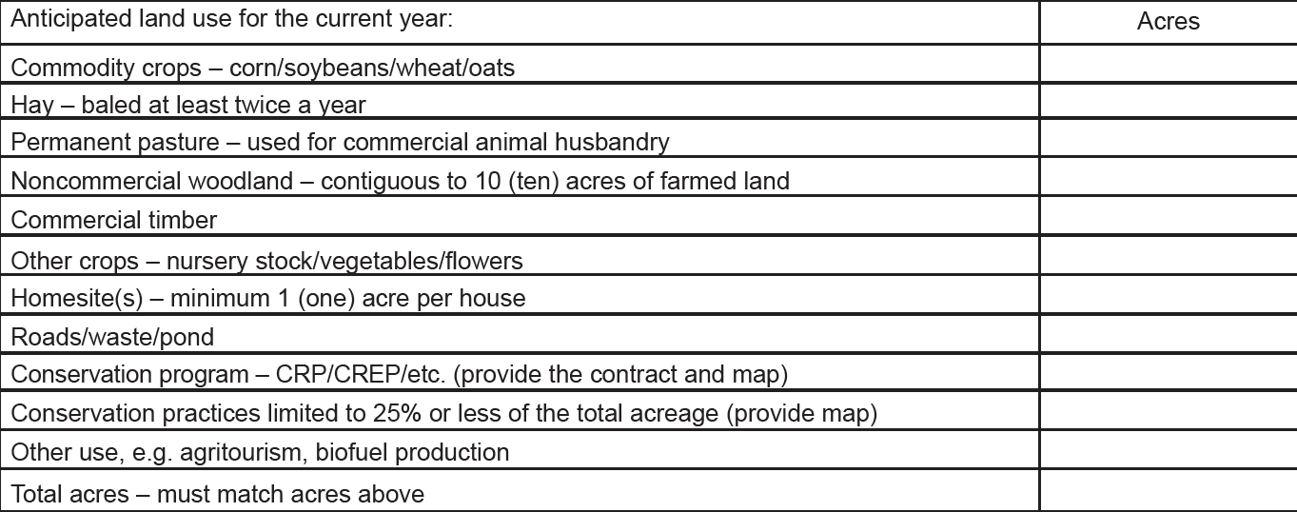
What land use qualifies to be on CAUV?
Notes:
Here is a screenshot of what is on both the initial and renewal application that must be filled out according to the use of your land:
Commercial crops (corn/soybeans/wheat/oats)
Hay- Baled at least twice a year.
Permanent pasture
Noncommercial woodland- contiguous to 10 acres of farmed land
Commercial Timber
Other crops (nursery stock/vegetables/flowers
Homesite(s)- minimum 1 acre per house.
Roads/waste/ponds
Conservation program ( such as CRP or CREPS) (provide map)
Conservation practices limited to 25% or less of the total acreage (provide map)
Other usages (agritourism, biofuel production)

Slide 11
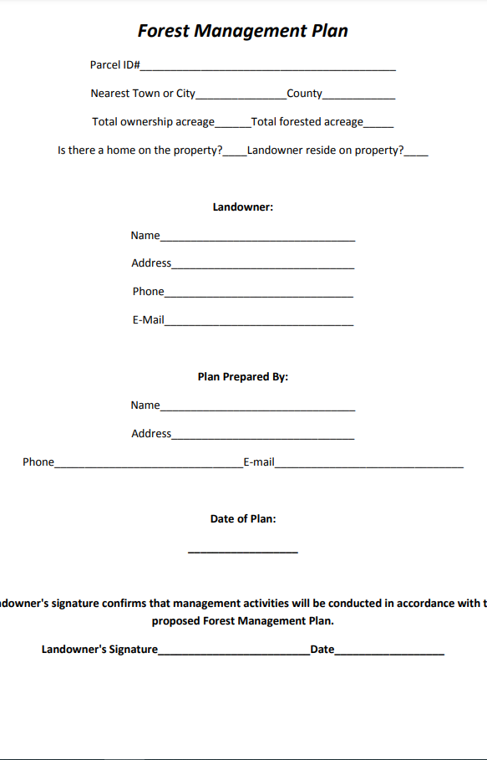
For woodland do I need a forestry management plan?
For noncommercial you do not, as long as it is contiguous to at least 10 acres of farmed land.
If only Commercial Timber you will need a management plan to qualify for CAUV. Please ask if you need phone numbers of a certified forester, we can provide you with all of them in the state.
Notes:
For noncommercial you will not need a forestry management plan as long as the woodland is contiguous to at least 10 acres of farmed land.
For commercial timber to qualify on CAUV you will have to have a forestry management plan. If you have one it must be turned in at the same time as your application, if you are in the works of getting a management plan then it must be turned in by the First Monday in August.
If the woodland is under 10 acres then will be considered noncommercial and have to be contiguous to at least 10 acres of farmed land.
If both the woodland and the farmed acres are less than 10 acres (seperatly) then proof of a $2500 gross annual income must be shown of the farmed land.

Slide 12
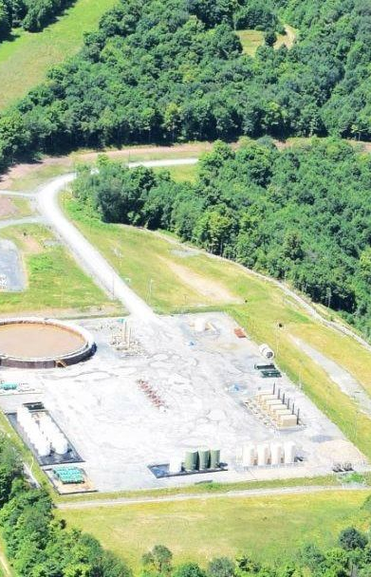
What if Oil & Gas is being produced on my property?
Yes, a well pad can qualify. This will be under “Other use e.g. agritourism, biofuel production.
This must be contiguous to at least 10 acres of farmed land.
Notes:
If you do have a well pad on your property you will still qualify, you will put this under “Other use e.g. agritourism, biofuel production”
This must be contiguous to at least 10 acres of farmed land.

Slide 13
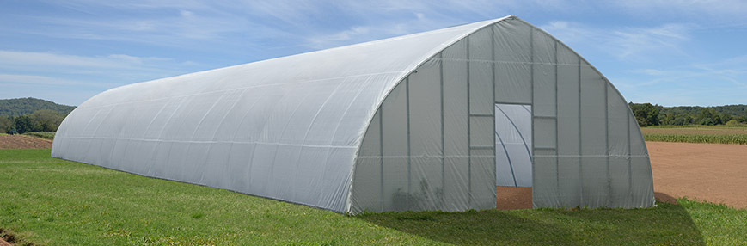
What if I have a greenhouse?
You will still qualify! This will be considered “Other crops- nursery stock/vegetables/flowers.”
With a greenhouse, you may have to show a gross annual income of $2,500 or have farmland on the same property as well.
Notes:
You will still qualify! A greenhouse is considered “Other crop (nursery stock/vegetables/flowers)”
With a greenhouse you may have to show a gross annual income of $2,500 or have farmed land on the same property as well.

Slide 14

What happens if I sell my land?
You and the buyer will have to work together and discuss what may happen.
Is the buyer going to keep farming? If yes then they will need to apply themselves for CAUV.
If the buyer does not wish to continue to be in CAUV, then you and the buyer may have to discuss an arrangement.
Notes:
If you do sell your land, you and the buyer will have to work together and discuss what may happen.
If the buyer is going to keep farming the land or use the woodland as commercial timber and plans to get a forestry management plan then they will apply as an “Initial applicant” for CAUV.
If the buyer does not want to stay on CAUV you an the buyer will have to discuss an arrangement between you and the buyer!

Slide 15
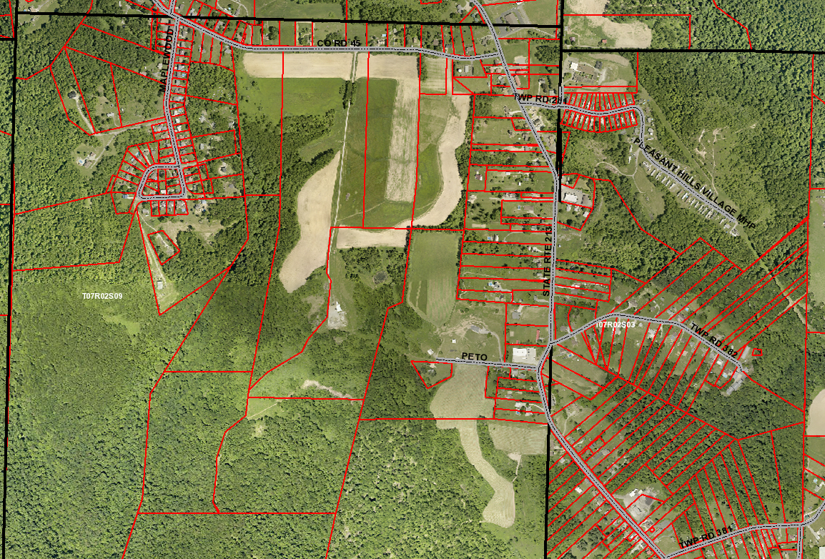
Do I need maps of my land? Where can I get them?
Having a map will help.
You can contact the Jefferson Soil and Water Office for help on getting a map.
If you have a map for a conservation program or a conservation practice, then having an extra map will not be necessary.
Notes:
Having a map is not necessary but will help.
If you contact the Jefferson Soil and Water office we can help you get a map of your property! If you do not have a map prior to filling out an application as a first applicant, that will be fine we can get the map for you!
If you have a map for a conservation program or conservation practice it will not be necessary to have another map.

Slide 16
Questions about Initial or Renewal Applications
Jefferson SWCD-
Crystal Conaway
(740)-264-9790
crystalconaway@jeffersoncountyoh.com
Auditors Office
(740)283-8518
Notes:
For further questions you can reach out to us at the following ways: Jefferson Soil and Water (Kirsten Zwick at 740-264-9790
OR Auditors Office at 740-283-8518

